Slide 1

Much ado about mirrors
by Michael C. Corballis

Slide 2



Contents
Introduction
Keywords
What mirrors actually do?
The Role of Symmetry
The Role of Rotation
The Nature if Left and Right
Summary
What next?

Slide 3
Introduction
Takano(1998) – 4 different types of reversals – Why mirrors reverse left and right and not up and down or back or front?
Reverse about their own planes.
Enantiomorph – reflection + rotation + translocation.
Two objects – enantiomorphs? Reversal about the axis of least asymmetry, align.
Canonical orientation – top- bottom, up- down
Reversal – left- right
Where is mirror located?
Mirror image relationship
What is viewed in the mirror?

Slide 4
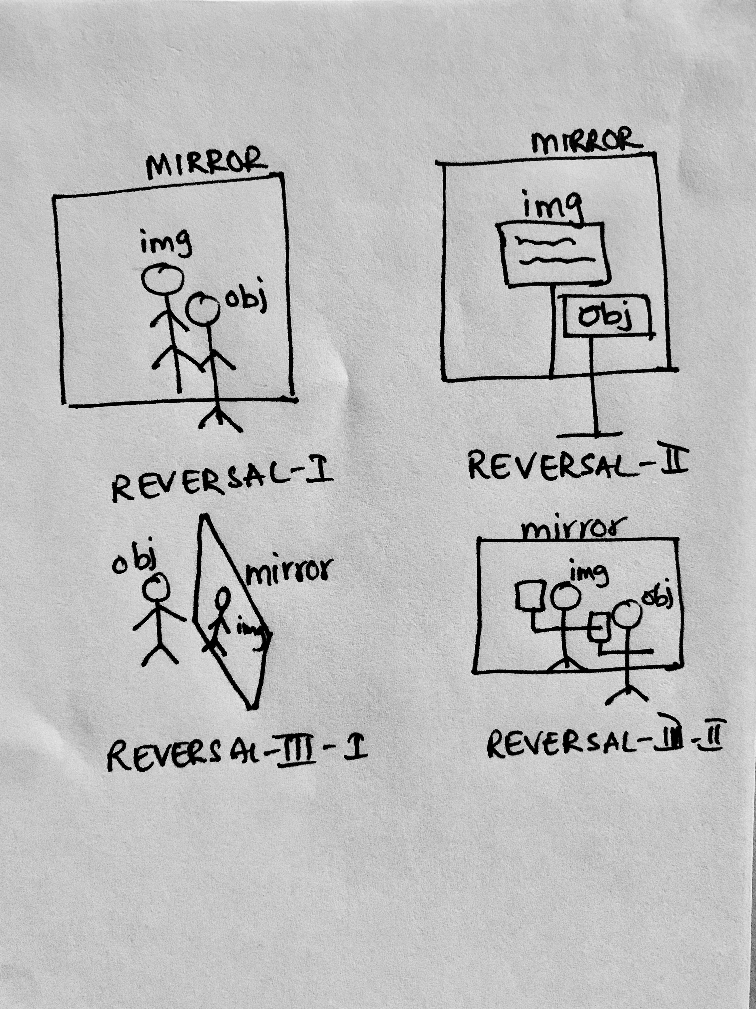
Objection
Different placement of mirror, different image
Takano restricted his analysis to self reflection, reflection of script.

Slide 5
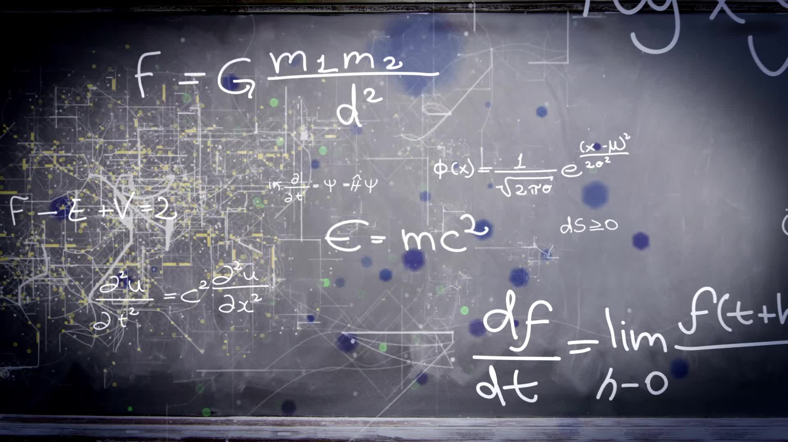
Keywords
Canonical orientation
Enantiomorph
Axis of least asymmetry
Bilateral symmetry

Slide 6
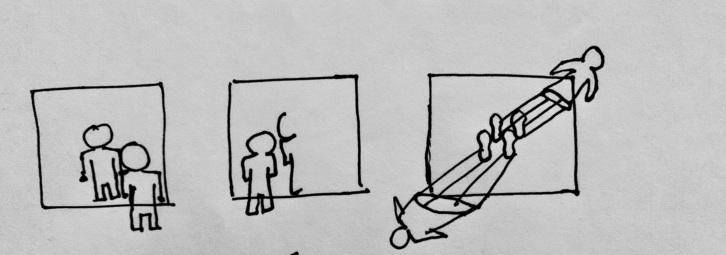
What mirrors actually do?
Reverses the direction perpendicular to its surface.
Translocation
Rotations, translocations are taken for granted.
Reason: free to move around in space.
Enantiomorphs of an object – turning an object 1D higher than the dimensionality of object.
What about 3D objects and its enantiomorphs??

Slide 7
Reference systems
Why do mirrors reverse right/left but not up/down?
Environment - centered
Object –
centered
Every placement of mirror different image
One enantiomorph
Why are enantiomorphs generally perceived as left-right reversals and not as reversals along some other axis?
* Enantiomorph == object if one or more axes of symmetry
Asymmetrical objects invite paradox Eg: shoes
Left- right reversal is the most common reversal

Slide 8
The role of Symmetry
Many objects – more or less Bilaterally symmetrical
“An object appears to differ from it’s enantiomorph by an apparent reversal along the axis of least perceived asymmetry”.
Some arbitrary shapes without canonical axes – cannot be seen as left-right reversed.
- Reflection along the lease perceived asymmetry.
There is a marked tendency to see the enantiomorphs as left-right reversed.

Slide 9
The role of Rotation
A shoe lying on floor – recognize it as shoe, but not if it’s left or right shoe without rotating.
*Rotate it mentally, physically
Discrimination of enantiomorph
Depends on alignment
Act of rotation

Slide 10
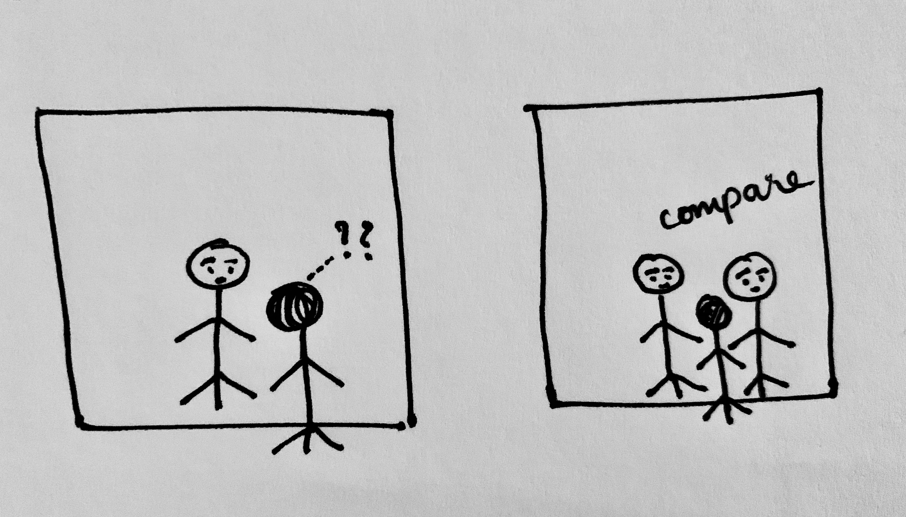
Easy to perceive relation as a reflection along the axis perpendicular to the mirror.
Study:
Pairs of drawings of 3D objects were given.
Subjects were asked to decide whether they were same or different.
Subjects mentally rotated them into an alignment.
*For objects without canonical axes, the objects are aligned so that the reflection is about the axes of least asymmetry.
Example: p,q,b,d – 4 letters, two enantiomorphs
Mirror images are top-bottom, left-right

Slide 11
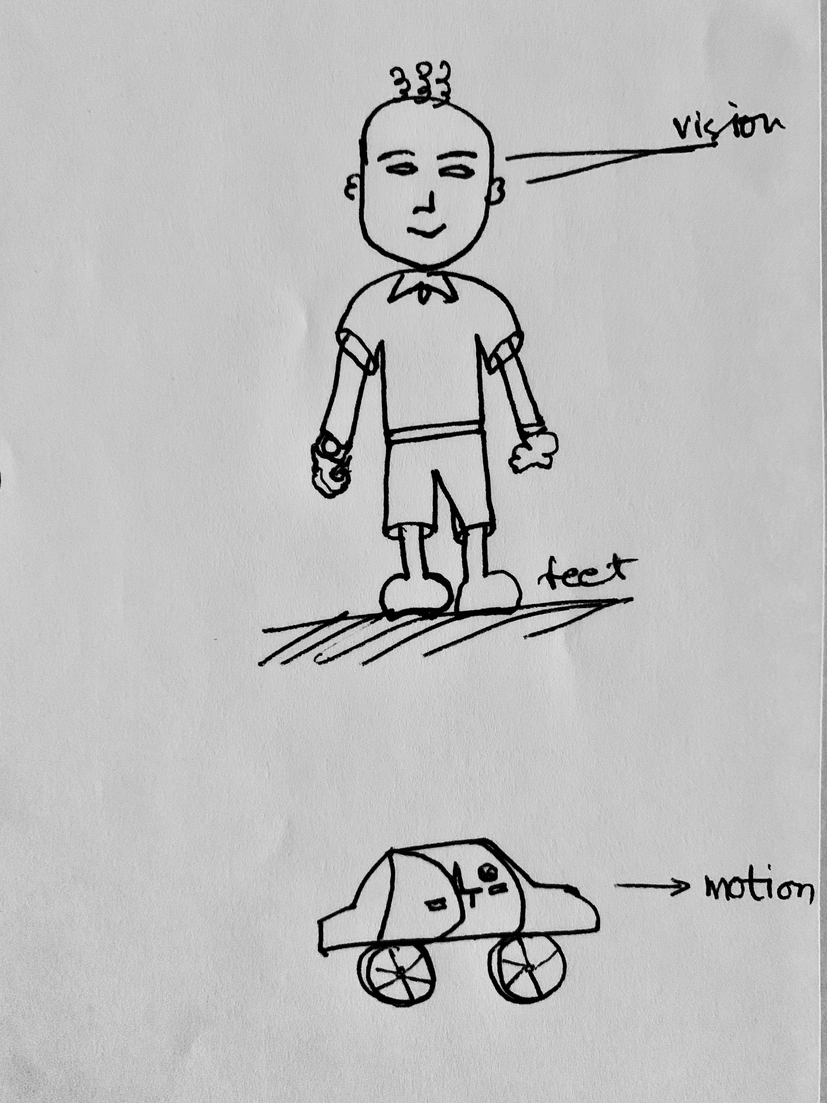
The nature of Left and Right
Identification of canonical axes is more than just social convention.
Top-bottom, front- back must be established before left-right dimension axis.
Logical priority
Top-bottom
front-back
Gravity
Functional properties
*have functional significance

Slide 12
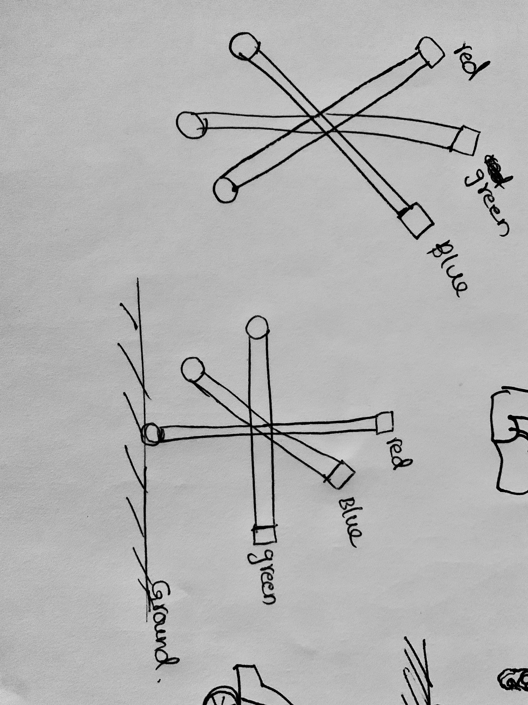
Humans have built in tendency to generalize objects to their left-right mirror images
Most 3D objects have established canonical axes , happen to be less asymmetrical along left – right than about other two axes.
Left-right axis is perceived as the axis of least asymmetry (but not always)
After rotation
Before rotation

Slide 13
Summary
In environmental coordinates, Mirror reverses about its own plane along the axis perpendicular to that plane.
W.r.t object centered coordinates, one object – one enantiomorph
To Understand the enantiomorphic relation, one must properly align the enantiomorphs (mentally). There is a marked tendency to align them, such that they are reflected along the axis of least asymmetry.
When canonical axes are defined, there is a strong tendency to rotate top- bottom, front-back axes to make it left-right reversal.
Left-right axis is special because it depends on top-bottom, front-back establishment.
Top-bottom, back-front axes are for canonical orientation of object, leaving the left-right axes to carry the burden of the reversal.

Slide 14
What next?
Gardner M : The ambidextrous universe, New York :basic books

